Slide 1
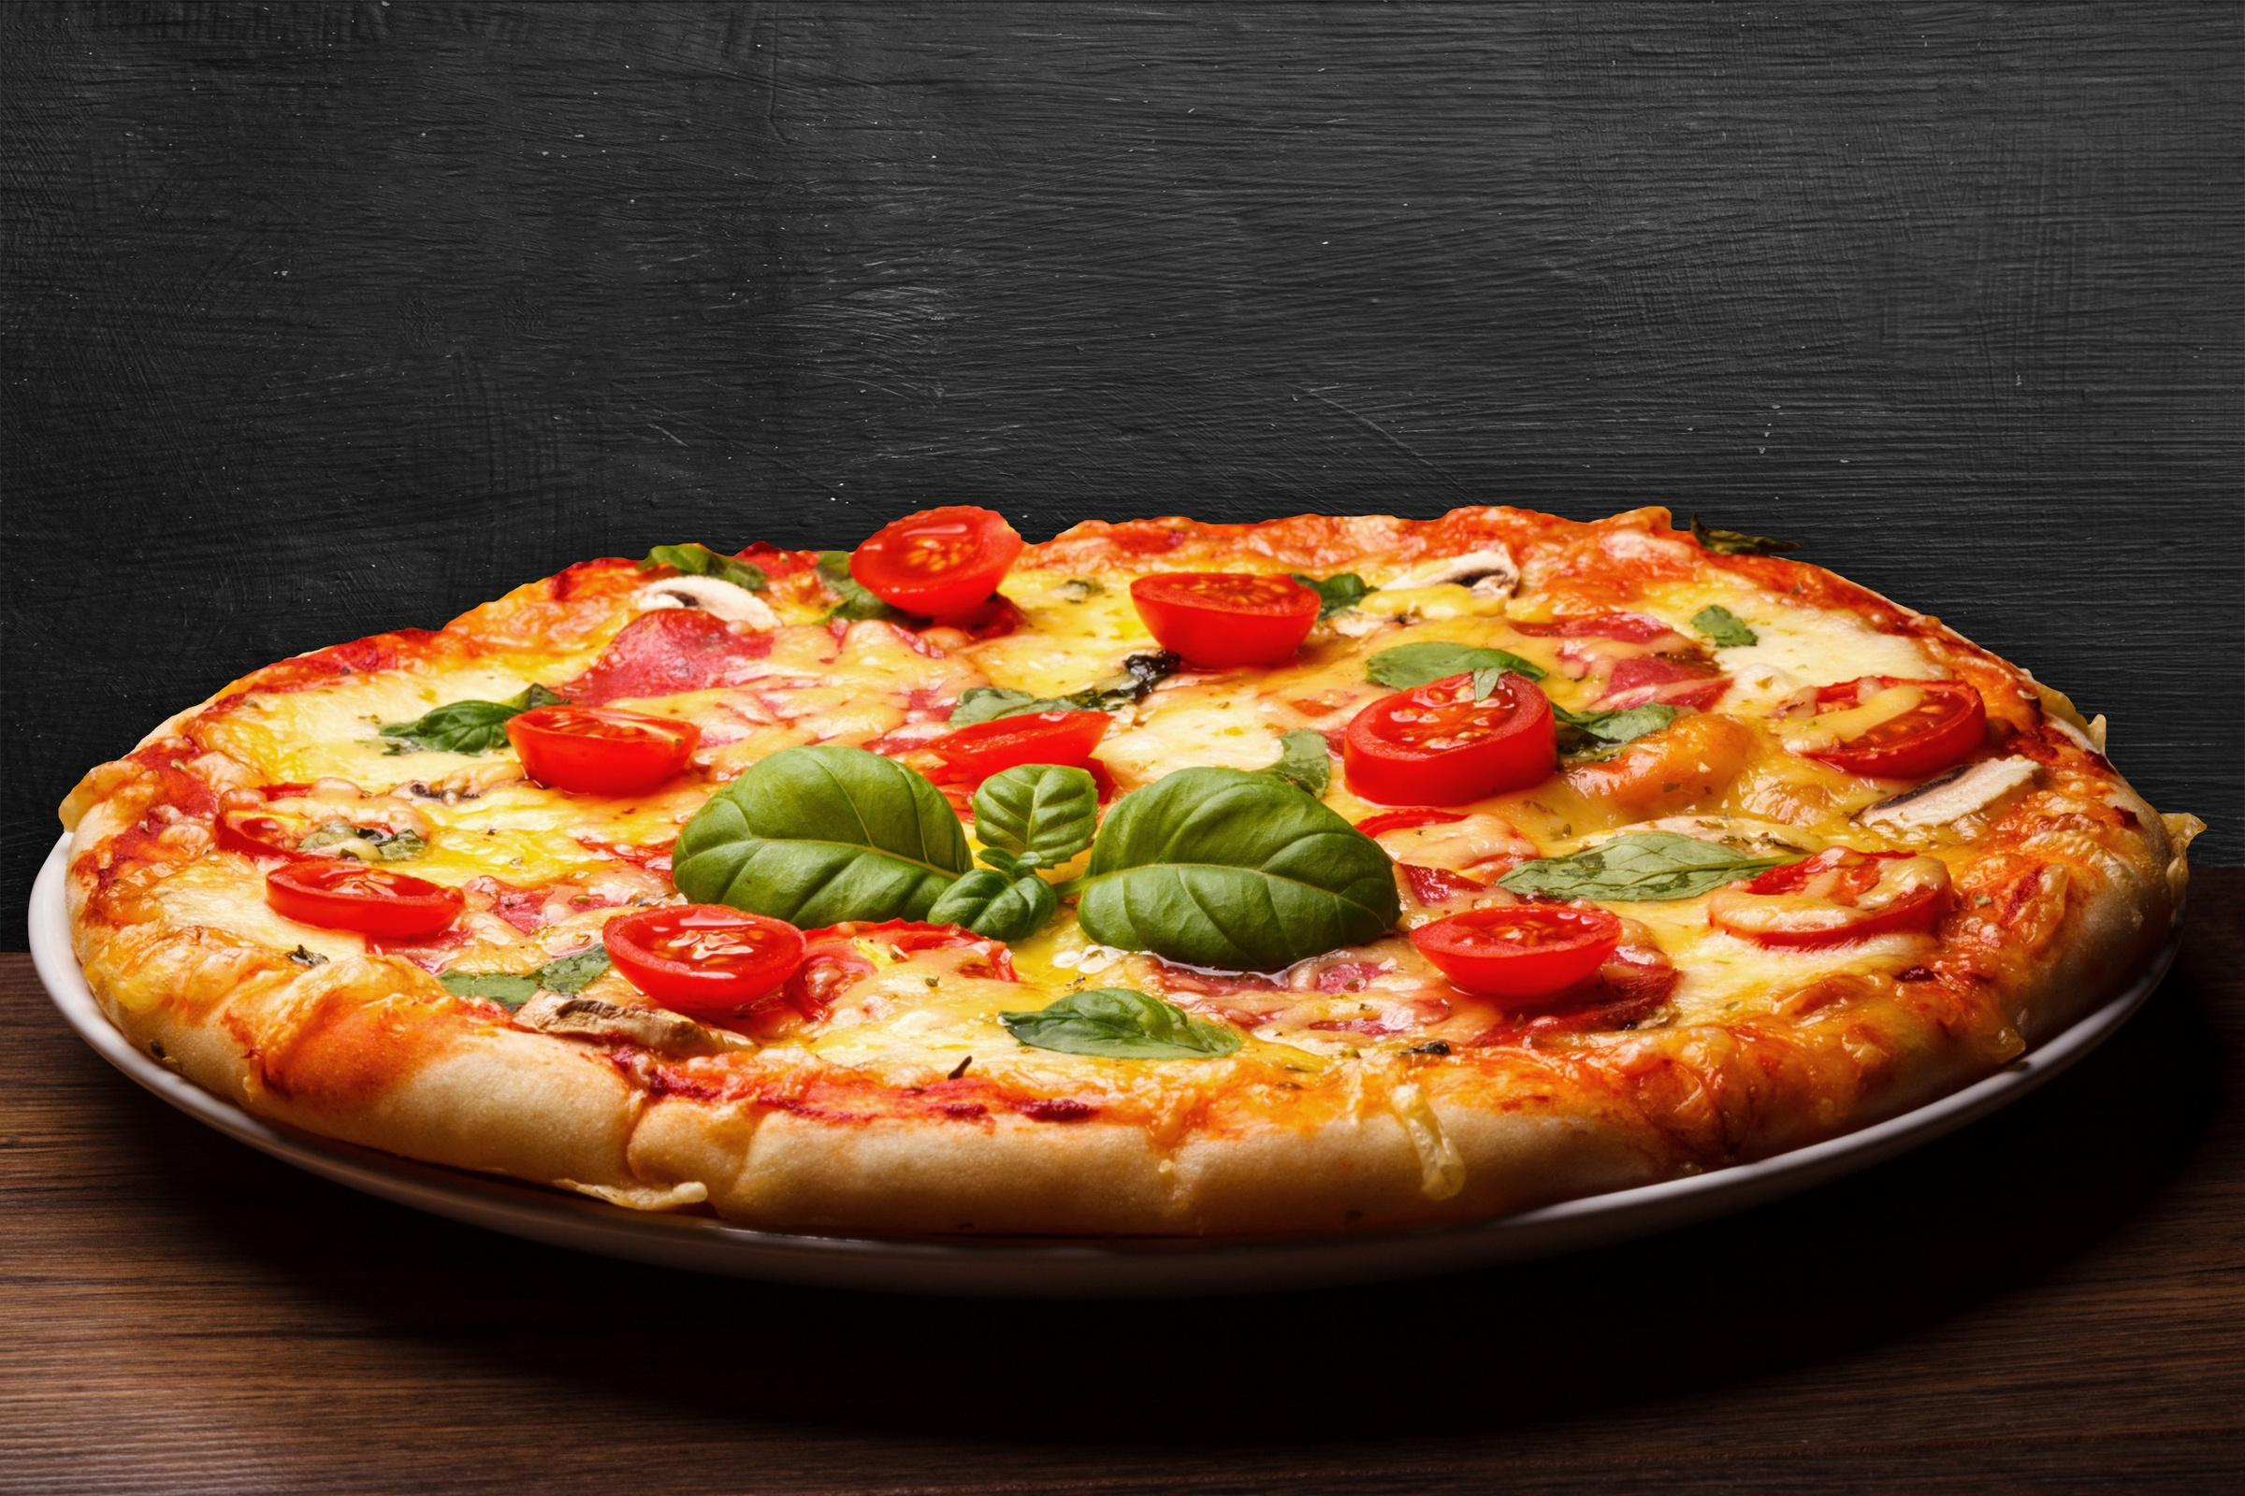

larana pizza
PIZZAS SALES

Slide 2


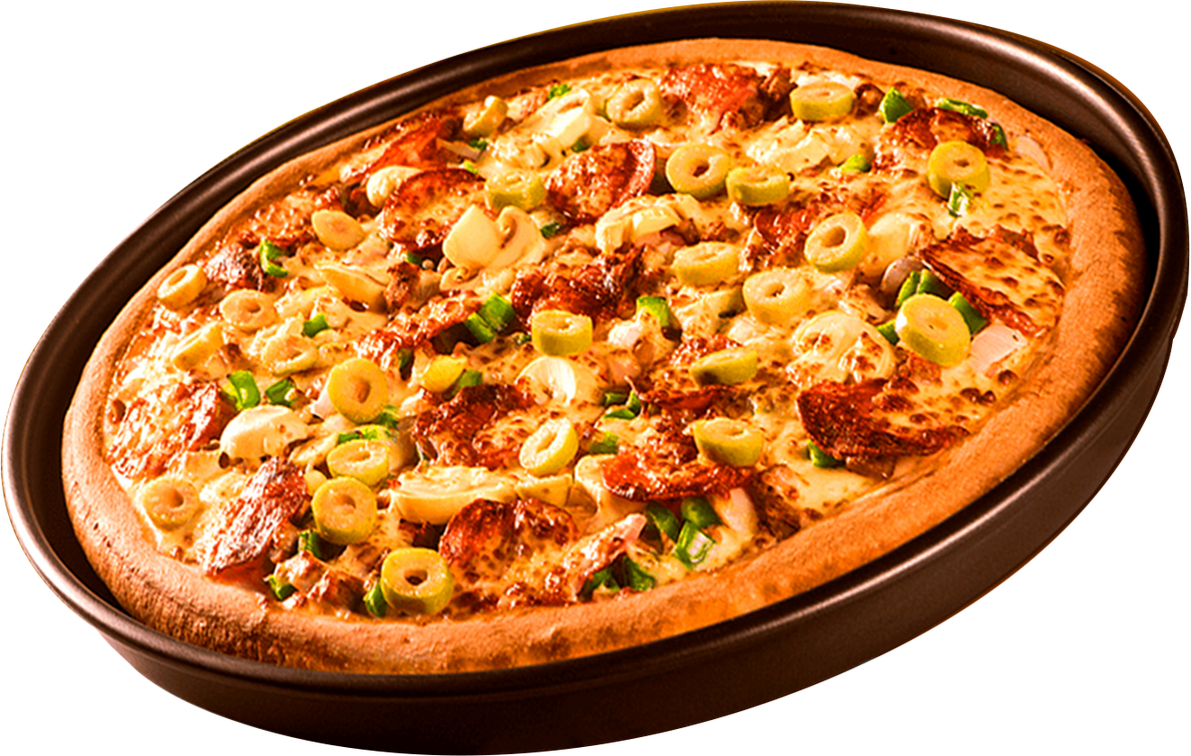

Hello Everyone
My name is Amit Kumar, and in this project, I have utilized MYSQL queries
to solve the question related to pizza sales.

Slide 3

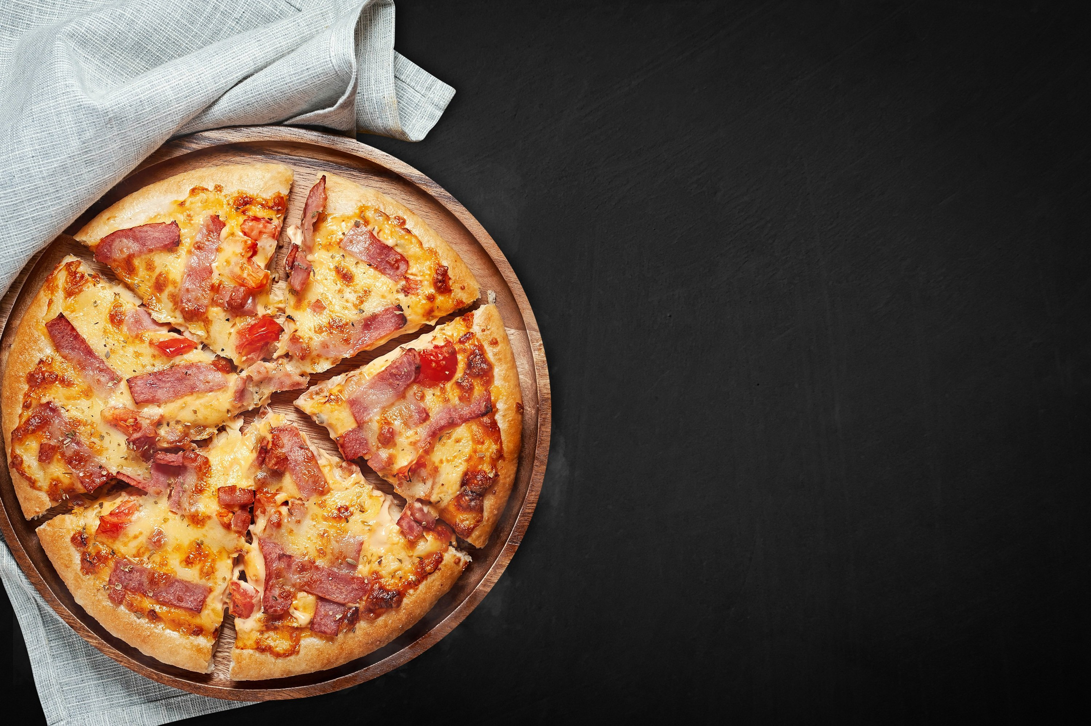
Retrieve the total number of orders placed.
Calculate the total revenue generated from pizza sales.
Identify the highest-priced pizza.
Identify the most common pizza size ordered.
List the top 5 most ordered pizza types along with their quantities.
Join the necessary tables to find the total quantity of each pizza category ordered.
Determine the distribution of orders by hour of the day.
Join relevant tables to find the category-wise distribution of pizzas.
Group the orders by date and calculate the average number of pizzas ordered per day.
Determine the top 3 most ordered pizza types based on revenue.
Calculate the percentage contribution of each pizza type to total revenue.
Analyze the cumulative revenue generated over time.
Determine the top 3 most ordered pizza types based on revenue for each pizza category.

Slide 4
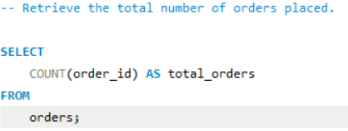
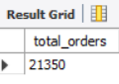

Slide 5
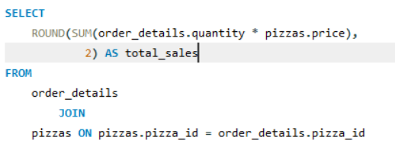
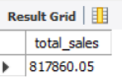
-- Calculate the total revenue generated from pizza sales.

Slide 6
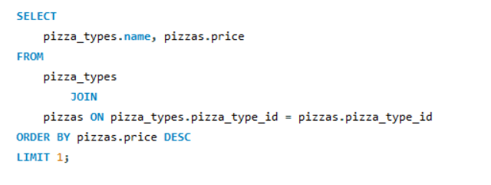
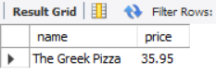
Identify the highest-priced pizza.

Slide 7
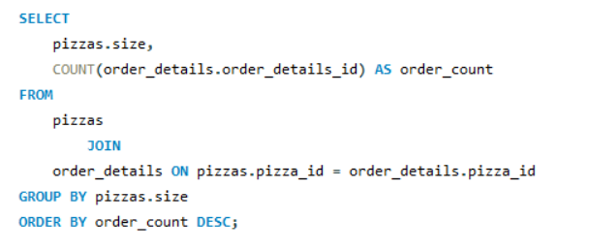
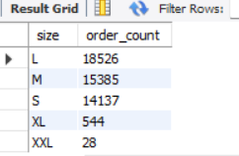
Identify the most common pizza size ordered

Slide 8
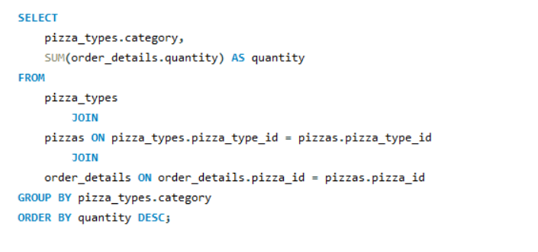
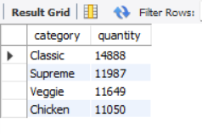
Join the necessary tables to find the total quantity of each pizza category ordered

Slide 9
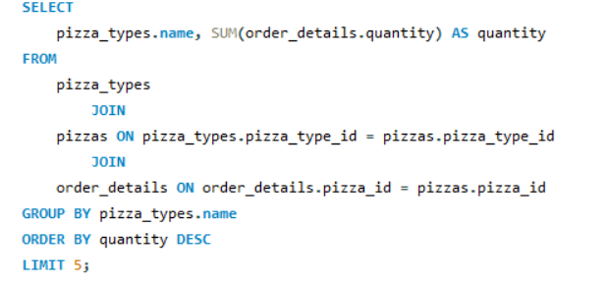
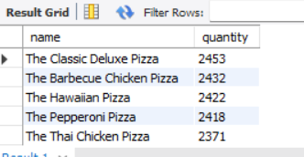
List the top 5 most ordered pizza types along with their quantities.

Slide 10
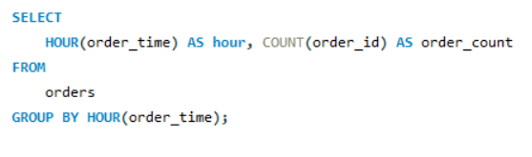
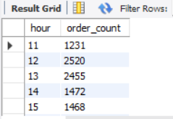
Determine the distribution of orders by hour of the day

Slide 11
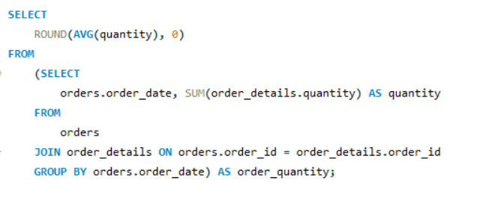
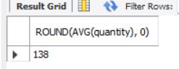
Group the orders by date and calculate the average
number of pizzas ordered per day.

Slide 12
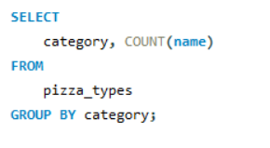
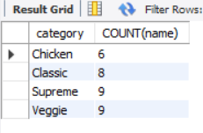
Join relevant tables to find the category-wise distribution of pizzas

Slide 13
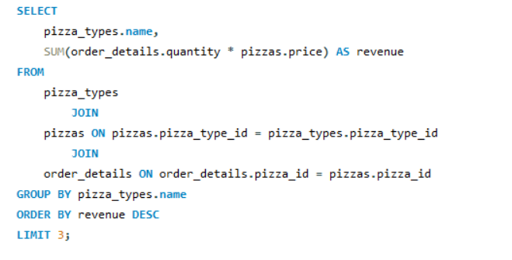
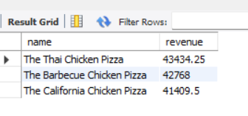
Determine the top 3 most ordered pizza types based on revenue

Slide 14
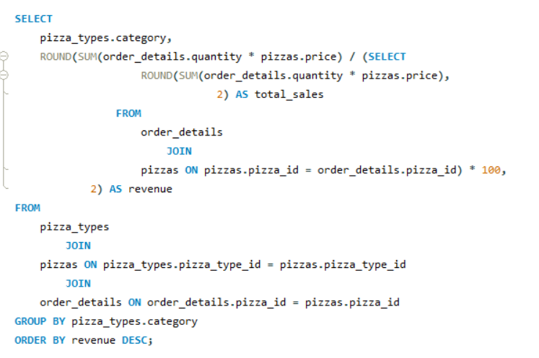
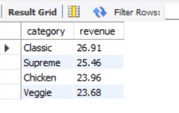
- Calculate the percentage contribution of each pizza type to total revenue.

Slide 15
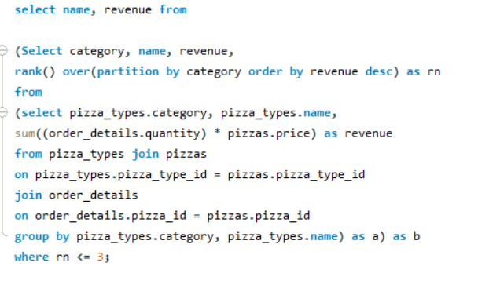
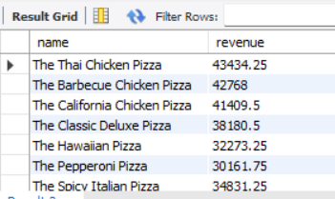
Determine the top 3 most ordered pizza types
based on revenue for each pizza category.

Slide 16
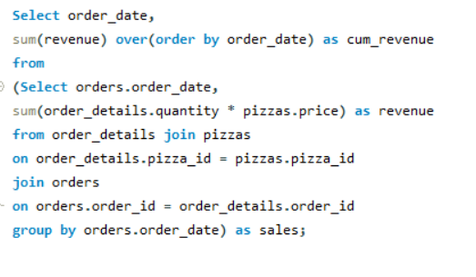
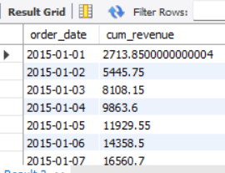
Analyze the cumulative revenue generated over time.

Slide 17
thank you!

